Slide 1
.NET Core Interview Question & Answer
https://interviewmonkey.com/-net-core-interview-questions/3/1

Slide 2
What is Kestral in C# Asp.net Core?
Kestrel is a cross-platform web server for ASP.NET Core. It is supported on all platforms and versions that .NET Core supports.
It is included by default as internal server in ASP.NET Core. Kestrel can be used, by itself as an edge server i.e Internet-facing web server that can directly process the incoming HTTP requests from the client. In Kestrel, the process used to host the app is dotnet.exe.
Kestrel is not used with InProcess hosting model.
With Out of Process Hosting model, Kestrel can be used in one of the following 2 ways.
  Kestrel can be used as the internet facing web server
  Kestrel can also be used in combination with a reverse proxy server
When we run the asp.net core application using the .NET core CLI, Kestrel is the only web server that is used to handle and process the incoming HTTP request.

Slide 3
What is routing in C# ASP.NET Core?
Routing is used to map requests to route handlers.
Routes are configured when the application starts up, and can extract values from the URL that will be used for request processing.

Slide 4
What is the difference between IApplicationBuilder.Use() and IApplicationBuilder.Run() C# Asp.net Core?
We can use both the methods in Configure methods of startup class. Both are used to add middleware delegate to the application request pipeline. The middleware adds using IApplicationBuilder.Use may call the next middleware in the pipeline whereas the middleware adds using IApplicationBuilder.Run method never calls the subsequent ore next middleware. After IApplicationBuilder.Run method, system stop adding middleware in request pipeline.
We can configure middleware in the Configure method of the Startup class using IApplicationBuilder instance.
Run() is an extension method on IApplicationBuilder instance which adds a terminal middleware to the application's request pipeline.
The Run method is an extension method on IApplicationBuilder and accepts a parameter of RequestDelegate.
signature of the Run method
  public static void Run(this IApplicationBuilder app, RequestDelegate handler)
signature of RequestDelegate
  public delegate Task RequestDelegate(HttpContext context);
To configure multiple middleware, use Use() extension method. It is similar to Run() method except that it includes next parameter to invoke next middleware in the sequence

Slide 5
What is the role of IWebHostEnvironment interface in C# ASP.NET Core?
IWebHostEnvironment Provides information about the web hosting environment an application is running in.
belongs to namespace Microsoft.AspNetCore.Hosting
The IWebHostEnvironment interface need to be injected as dependency in the Controller and then later used throughout the Controller.
The IWebHostEnvironment interface have two properties.
  WebRootPath − Path of the www folder(Gets or sets the absolute path to the directory that contains the web-servable application content files)
  ContentRootPath − Path of the root folder which contains all the Application files(Gets or sets an IFileProvider pointing at WebRootPath.)

Slide 6
What are the benefits of choosing ASP.NET Core over ASP.NET?
ASP.NET Core is a high-performance, cross-platform, and open-source framework. It allows you to build modern, cloud-enabled, and Internet-connected apps.
With ASP.NET Core, you can:
  Build web applications and services, Internet of Things (IoT) apps, and backends for mobile applications.
  Work on your favourite operating system such as Windows, macOS, or Linux, and choose the tools and IDEs of your choice.
  Develop on and Deploy to the cloud or on-premises.
  Take advantage of containers and Docker to ease the deployment and distribution of your application.
  Run on the modern, fast, lightweight .NET Core framework.

Slide 7
Benefits of the ASP.NET Core framework over the ASP.NET framework
High Performance: ASP.NET Core framework is designed from scratch, keeping performance in mind. The ASP.NET team has focused on making the default web server, Kestrel, as fast as possible. TechEmpower, which has been running benchmarks on various frameworks, lists the ASP.NET Core with Kestrel as the fastest over 400 frameworks.
Cross-Platform: ASP.NET Core runs on the cross-platform .NET 5.0 platform. It is not tied to a Windows operating system, like the legacy ASP.NET framework. You can develop and run production-ready ASP.NET Core apps on Linux or a Mac. If you decide to use Linux, you don't have to pay for Windows licenses, resulting in significant cost savings.
Open Source: ASP.NET Core is open-source and actively developed on GitHub by thousands of developers all over the world, along with Microsoft. All the source code is hosted on GitHub for anyone to see, change and contribute back.

Slide 8
What is the purpose of Program.cs file in C# ASP.NET Core project?
ASP.NET Core web application is actually a console project which starts executing from the entry point public static void Main() in Program class where we can create a host for the web application.

Slide 9
What is ASP.NET Core
ASP.NET Core is a cross-platform, high-performance, open-source framework for building modern, cloud-enabled, Internet-connected apps. It is not an upgraded version of ASP.NET. ASP.NET Core is completely rewriting that work with .net Core framework.
With ASP.NET Core, you can:
  Build web apps and services, Internet of Things (IoT) apps, and mobile backends.
  Use your favorite development tools on Windows, macOS, and Linux.
  Deploy to the cloud or on-premises.
  Run on .NET Core.

Slide 10
How C# ASP.NET Core Middleware is different from HttpModule?
HttpModules are configured via web.config or global.asax Developer don’t have control on order of execution.
As order of modules is mainly based on application life cycle events. The execution order remains same for requests and responses.
HttpModules helps you to attach code specific to a application events. HttpModules are tied to System.web.
Middleware are configured in Startup.cs code rather than web.config file (entry point for application)
Unlike HttpModules, there is full control of what get’s executed and in what order. As they are executed in the order in which they are added.
Order of middleware for responses is the reverse from that for requests.
Middleware is independent of these events.
Middlewares are host independent.
Built in Middlewares of Asp.Net core
Authentication Provides authentication support.
CORS Configures Cross-Origin Resource Sharing.
Routing Define and constrain request routes.
Session Provides support for managing user sessions.
Diagnostics Includes support for error pages and runtime information.

Slide 11
What are the various JSON files available in C# ASP.NET Core?
ASP.net Core is re-architected from prior versions of ASP.net,where the configuration was relying on System.Configuration and xml configurations in web.config file. In ASP.net Core, a new easy way to declare and access the global settings for solution, project specific settings,client specific settings etc..The new configuration model, works with XML,INI and JSON files.
Different configuration json files in ASP.net Core There are mainly 6 configuration JSON files in ASP.net Core.
  global.json
  launchsettings.json
  appsettings.json
  bundleconfig.json
  project.json
  bower.json

Slide 12
What is the use of the Configure() method of startup class in C# Asp.net Core?
The configure method is present inside startup class of ASP.NET Core application
The Configure method is a place where you can configure application request pipeline for your application using IApplicationBuilder instance that is provided by the built-in IoC container
The Configure method by default has these three parameters IApplicationBuilder, IWebHostEnvironment and ILoggerFactory .
At run time, the ConfigureServices method is called before the Configure method. This is to register custom service with the IoC container which can be used in Configure method.
IWebHostEnvironment :Provides information about the web hosting environment an application is running in.
IApplicationBuilder:Defines a class that provides the mechanisms to configure an application's request pipeline.

Slide 13
Explain the purpose of the Startup class in ASP.NET Core
The Startup class configures your application's services and defines the middleware pipeline.
Generally speaking, the Program class is where you configure your application's infrastructure, such as the HTTP server, integration with IIS, and configuration sources. In contrast, the Startup class defines which components and features your application uses and the middleware pipeline for your app.

Slide 14
What is the use of UseIISIntegration in C# Asp.net Core?
All ASP.NET Core applications require a WebHost object that essentially serves as the application and web server. WebHostBuilder is used to configure and create the WebHost. You will normally see UseKestrel() and UseIISIntegration() in the WebHostBuilder setup code.
What do these do?
UseKestrel() − This registers the IServer interface for Kestrel as the server that will be used to host your application.
In the future, there could be other options, including WebListener which will be Windows only.
UseIISIntegration() − This tells ASP.NET that IIS will be working as a reverse proxy in front of Kestrel.
This then specifies some settings around which port Kestrel should listen on, forwarding headers, and other details.

Slide 15
What is the use of "Map" extension while adding middleware to C# ASP.NET Core pipeline?
Middleware are software components that are assembled into an application pipeline to handle requests and responses.
Each component chooses whether to pass the request on to the next component in the pipeline, and can perform certain actions before and after the next component is invoked in the pipeline.
Map extensions are used as convention for branching the pipeline.
The Map extension method is used to match request delegates based on a request’s path. Map simply accepts a path and a function that configures a separate middleware pipeline.
In the following example, any request with the base path of /maptest will be handled by the pipeline configured in the HandleMapTest method.

Slide 16
What is Metapackage in C# Asp.net Core?
It is known that Microsoft.AspNetCore package is one of the packages added to many ASP.NET Core templates.
The Microsoft.AspNetCore package is repeatedly included as one of the usual project dependencies when opening a new ASP.NET Core project. It delivers many of the crucial packages to position up a basic ASP.NET Core application.
Though, this package does not contain any actual dlls or code itself, it merely contains a series of dependencies on additional packages. By adding this package to your project, you bring in all the relevant packages along with their dlls on which it depends and it is called a metapackage.

Slide 17
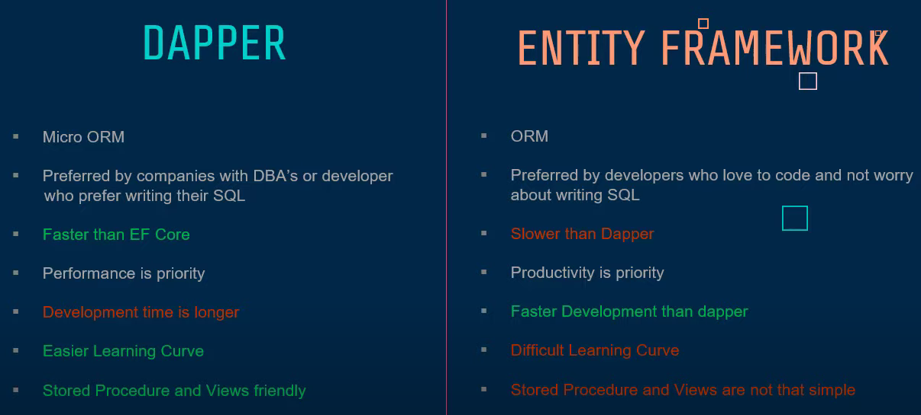
Dapper v/s Entity Framework(Core)

Slide 18
ado.net vs dapper

Slide 19
scoped vs transient vs singleton .net core
Transient objects are always different; a new instance is provided to every controller and every service.
Scoped objects are the same within a request, but different across different requests.
Singleton objects are the same for every object and every request.

